Slide 1
Microsoft Azure
An Introduction

Slide 2
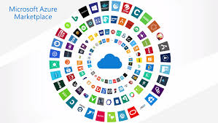
Introducing Microsoft Azure
Azure is a cloud computing platform and service created by Microsoft. It provides various services, including computing power, storage, and networking, which businesses and developers can use to build, manage, and deploy applications and services over the Internet.

Slide 3
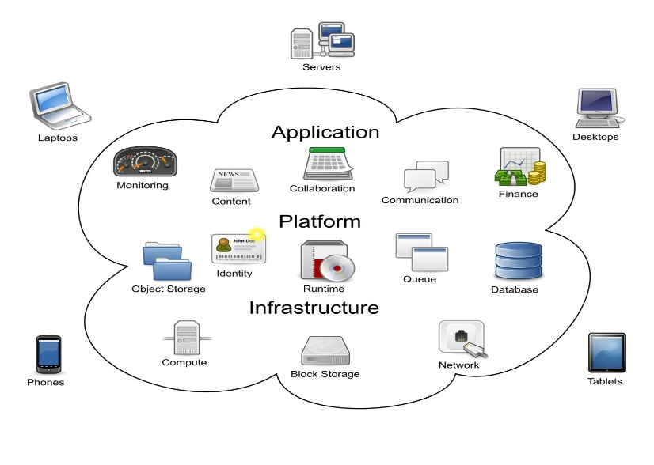
What is Cloud Computing?
Cloud computing is a technology that allows you to access and use computing resources like servers, storage, databases, and software over the internet instead of having physical hardware and software on your premises. This makes managing and scaling your IT needs easier and more cost-effective.

Slide 4
What is Microsoft Azure?
Open and Flexible Cloud Platform
Build, Deploy, and Manage Applications across Global Network
Build Applications using Any Language, Tool, or Framework
Integrate Public Cloud Applications with your Existing IT Environment

Slide 5
Why Use the Cloud?
Speed
Scale
Economics
Faster than Traditional Application Development
Scale out Quickly
Provide Global Scale
Lower Cost

Slide 6
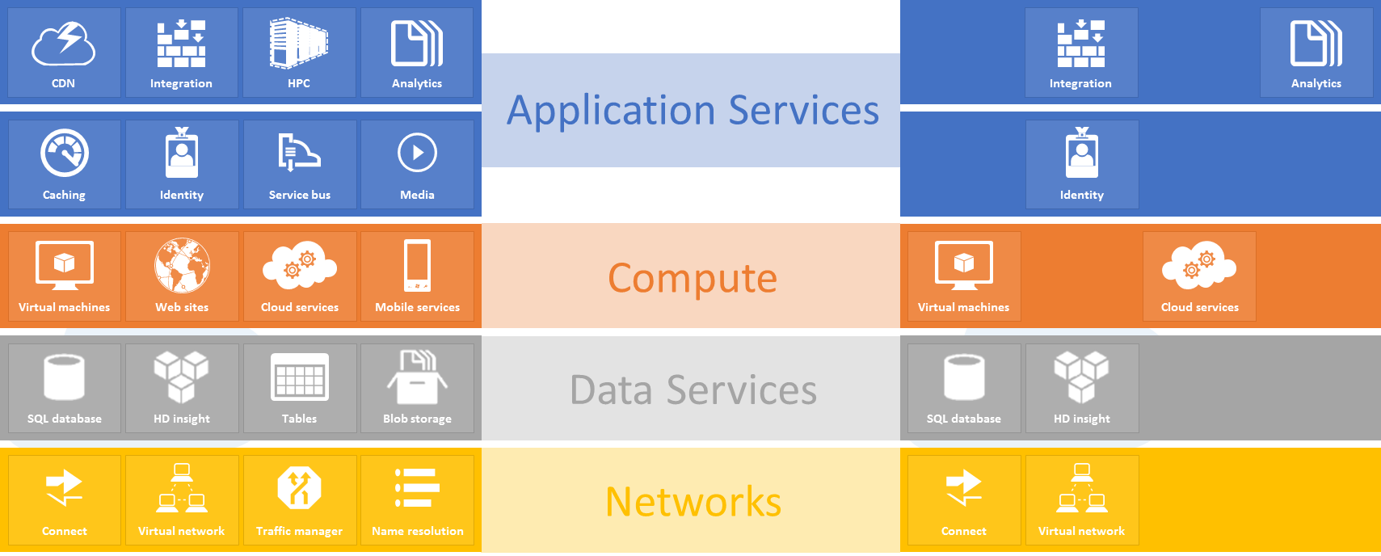
Microsoft Azure Services

Slide 7
Compute Services
Virtual Machines
Create, deploy, and manage virtual machines running in the Microsoft Azure cloud
Web Sites
Create new websites or migrate your existing business website into the cloud
Cloud Services
Build and deploy highly available and almost infinitely scalable applications with low administration costs
Mobile Services
Build and deploy apps and storing data for mobile devices

Slide 8
Network Services
Virtual Network
Treat the Microsoft Azure public cloud as if it is an extension of your on-premises data center
Traffic Manager
Route application traffic for the user who is using the application to Microsoft Azure data centers

Slide 9
Data Services
Data Management
Store your business data in SQL databases using Microsoft Azure SQL Database, using NoSQL Tables via REST, or using BLOB storage
Business Analytics
Enables ease of discovery and data enrichment using Microsoft SQL Server Reporting and Analysis Services
HDInsight
Brings a 100 percent Apache Hadoop solution to the cloud

Slide 10
Data Services (Cont.)
Cache
Provides a distributed caching solution that can help speed up your cloud-based applications and reduce database load
Backup
Helps to protect your server data offsite by using automated and manual backups to Microsoft Azure
Recovery Manager
Hyper-V Recovery Manager helps you protect business critical services by coordinating the replication and recovery of System Center 2012 private clouds

Slide 11
App Services
Media Services
Allows you to build workflows for the creation, management, and distribution of media using Azure public cloud
Messaging
Allows you to keep your apps connected across your private cloud environment and the Microsoft Azure public cloud
Notification Hubs
Provides a highly scalable, cross-platform push notification infrastructure for applications running on mobile devices

Slide 12
App Services (Cont.)
BizTalk Services
Provides Business-to-Business (B2B) and Enterprise Application Integration (EAI) capabilities for delivering cloud and hybrid integration solutions
Active Directory
Provides you with identity management and access control capabilities for your cloud applications
Multifactor Authentication
Provides an extra layer of authentication, in addition to the user’s account credentials, to better secure access for both on-premises and cloud applications

Slide 13
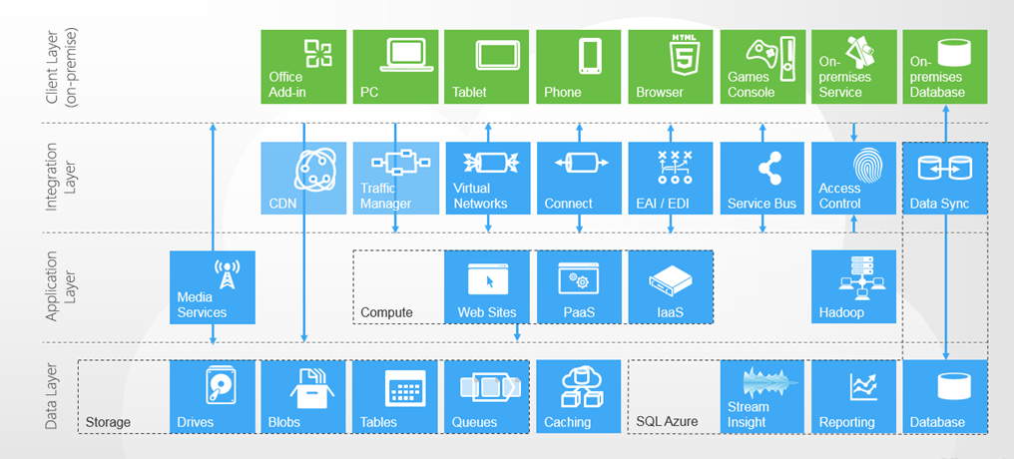
Azure Components

Slide 14
Microsoft Azure Pricing
The simple answer to how much Microsoft Azure costs to get started is easy. It is FREE! It is free to set up a Microsoft Azure account that gives you access to a trial account that you can use for testing.
Once you do set up this FREE account, you can convert it and all the machines on it to a PAY account. However, this is a MANUAL process.
Know more about Microsoft Azure pricing

Slide 15
Thank You!
References:
LinkedIn: https://www.linkedin.com/in/muhammad-abdullah-sheikh/
GitHub: https://github.com/me-abdullah

